Slide 1
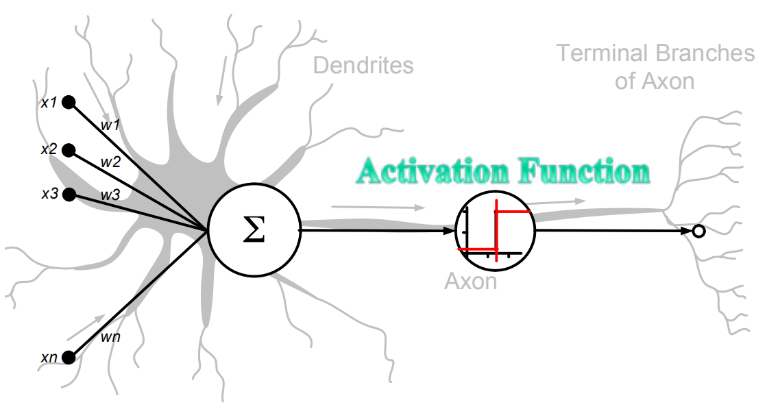
Biological Neuron Vs Artificial Neuron

Slide 2
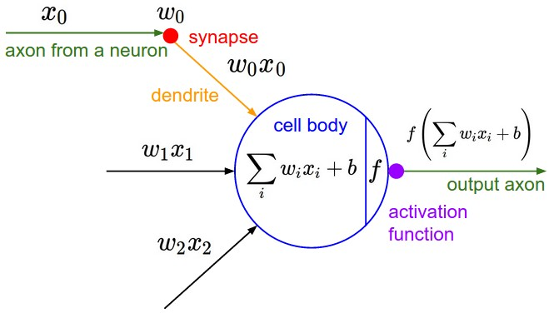
Artificial neuron

Slide 3
Important Points
An artificial neuron, also known as a perceptron or a node, is a fundamental unit in artificial neural networks.
The artificial neuron takes multiple input values, applies weights to these inputs, computes a weighted sum, adds a bias, and then passes the result through an activation function to produce an output.
Activation functions are crucial for introducing non-linearity to neural networks, allowing them to learn complex patterns.

Slide 4
Weights
Definition: Weights are numerical values assigned to the connections between neurons in a neural network.
Purpose: During forward propagation, each input is multiplied by its corresponding weight, influencing how strongly that input contributes to the neuron's output.
Learning Mechanism: Weights are updated during training using optimization algorithms (e.g., gradient descent) to minimize the error between predicted and actual outputs.
Role in Generalization: Well-tuned weights enable the neural network to generalize effectively to new, unseen data beyond the training set.

Slide 5
Biases
Definition: A bias is a constant added to a neuron's weighted input. It is not associated with any specific input feature.
Purpose: Biases allow neurons to learn patterns even when the weighted sum of inputs is insufficient, enabling the model to recognize patterns that do not pass through the origin.
Functionality:
Without biases, neurons activate only when the input reaches a specific threshold.
With biases, the activation function can shift, allowing greater flexibility in neuron activation.
Role in Learning: Biases enhance the flexibility and learning capacity of neural networks by acting as adjustable offsets.
Training: During backpropagation, both weights and biases are updated to minimize prediction error and improve model accuracy.

Slide 6
Activation functions in Neural Networks
It is a mathematical function applied to the output of a neuron.
It introduces non-linearity into the model, allowing the network to learn and represent complex patterns in the data.
Without this non-linearity feature a neural network would behave like a linear regression model no matter how many layers it has.

Slide 7
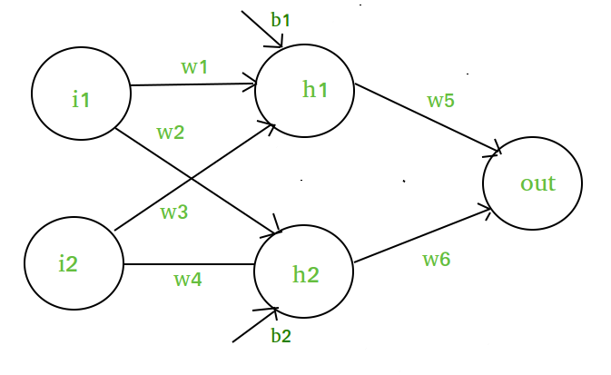
Mathematical Proof of Need of Non-Linearity in Neural Networks
Input Layer: Two inputs i1​ and i2​​​.
Hidden Layer: Two neuron h1​​ and h2​
Output Layer: One output neuron.

Slide 8
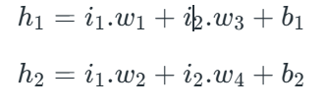

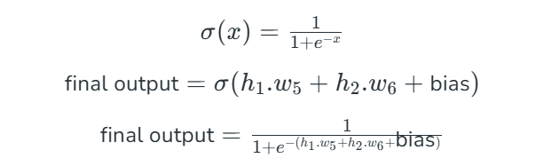
The input to the hidden neuron h1​ is calculated as a weighted sum of the inputs plus a bias:
In order to add non-linearity, we will be using sigmoid activation function in the output layer:
The output neuron is then a weighted sum of the hidden neuron's output plus a bias:
This gives the final output of the network after applying the sigmoid activation function in output layers, introducing the desired non-linearity.

Slide 9
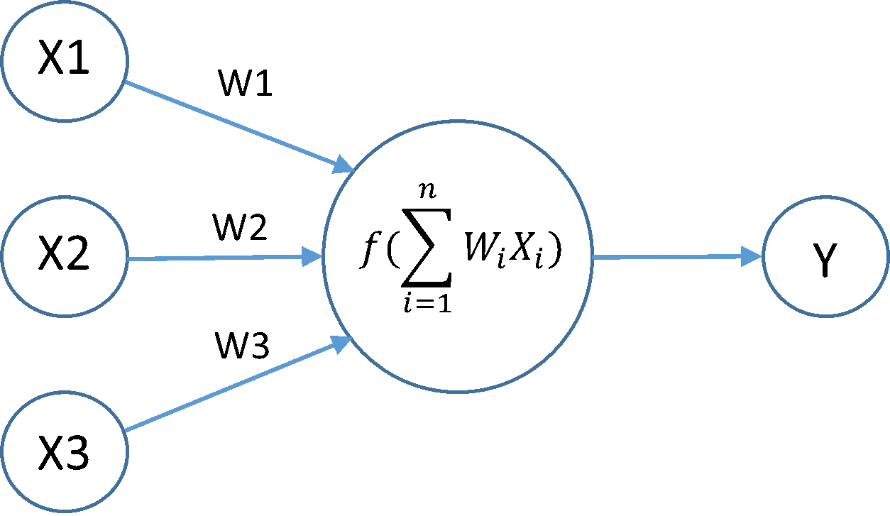
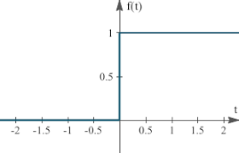
Artificial neuron
Weighted sum:
x1w1 + x2w2 + x3w3
= 0.2*-0.3 + 0.4*0.4 + 0.6*-0.8
= -0.06+0.16-0.48
= -0.38
Y= f(x1w1 + x2w2 + x3w3)
= f(-0.38) = 0
Suppose inputs,
x1= 0.2, x2=0.4, x3=0.6
And weights
W1= -0.3, w2= 0.4, w3= -0.8
Activation function:
Step Function (threshold)
1 if wixi > 0
and
0 if wixi ≤ 0

Slide 10
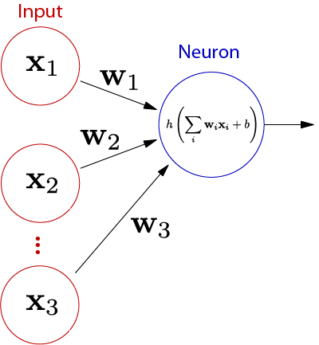
Artificial neuron
Weighted sum:
x1w1 + x2w2 + x3w3
= 0.2*-0.3 + 0.4*0.4 + 0.6*-0.8
= -0.06+0.16-0.48
= -0.38
Y= f(x1w1 + x2w2 + x3w3)
= f(-0.38) = 0
New output
Y= f(x1w1 + x2w2 + x3w3+b)
Y=f(-0.38+ 0.5)
Y=f(0.12) = 1
Suppose inputs,
x1= 0.2, x2=0.4, x3=0.6, b=0.5
And weights
W1= -0.3, w2= 0.4, w3= -0.8
Activation function:
Step Function (threshold)
1 if wixi > 0
and
0 if wixi ≤ 0

Slide 11
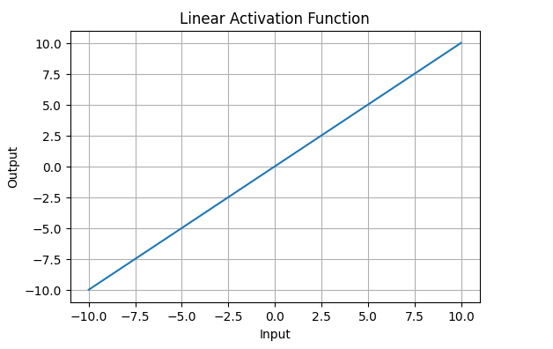
Types of Activation Functions in Deep Learning
1. Linear Activation Function
Linear Activation Function resembles straight line define by y=x.
The range of the output spans from (−∞ to +∞.
Linear activation function is used at just one place i.e. output layer.
Using linear activation across all layers makes the network's ability to learn complex patterns limited.
Linear activation functions are useful for specific tasks but must be combined with non-linear functions to enhance the neural network’s learning and predictive capabilities.

Slide 12
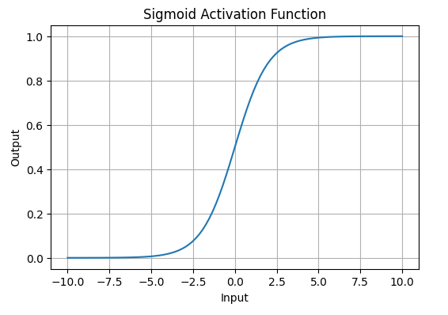
Non-Linear Activation Functions 1. Sigmoid Function
Sigmoid Activation Function is characterized by 'S' shape. It is mathematically defined as
This formula ensures a smooth and continuous output that is essential for gradient-based optimization methods.
It allows neural networks to handle and model complex patterns that linear equations cannot.
The output ranges between 0 and 1, hence useful for binary classification.
.

Slide 13
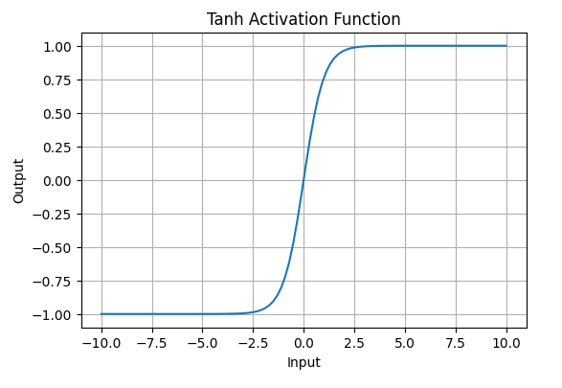
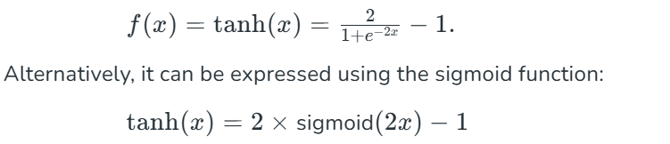
2. Tanh Activation Function
Tanh function (hyperbolic tangent function) is a shifted version of the sigmoid, allowing it to stretch across the y-axis. It is defined as:
Value Range: Outputs values from -1 to +1.
Non-linear: Enables modeling of complex data patterns.
Use in Hidden Layers: Commonly used in hidden layers due to its zero-centered output, facilitating easier learning for subsequent layers.

Slide 14
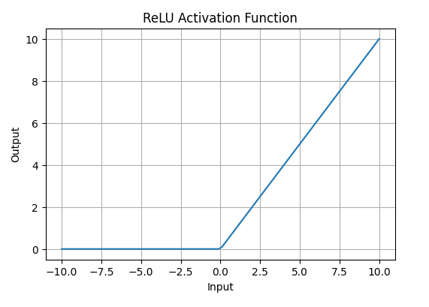
3. ReLU (Rectified Linear Unit) Function
ReLU activation is defined by A(x)=max⁡(0,x), this means that if the input x is positive, ReLU returns x, if the input is negative, it returns 0.
Value Range: [0,∞), meaning the function only outputs non-negative values.
Nature: It is a non-linear activation function, allowing neural networks to learn complex patterns and making backpropagation more efficient.
Advantage over other Activation: ReLU is less computationally expensive than tanh and sigmoid because it involves simpler mathematical operations. At a time only a few neurons are activated making the network sparse making it efficient and easy for computation.

Slide 15
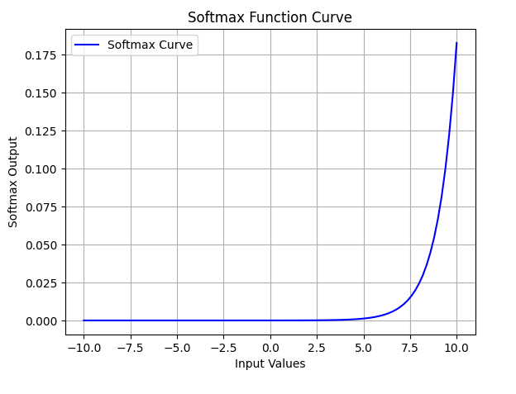
Exponential Linear Units 1. Softmax Function
Softmax function is designed to handle multi-class classification problems. It transforms raw output scores from a neural network into probabilities. It works by squashing the output values of each class into the range of 0 to 1 while ensuring that the sum of all probabilities equals 1.
Softmax is a non-linear activation function.
The Softmax function ensures that each class is assigned a probability, helping to identify which class the input belongs to.

Slide 16
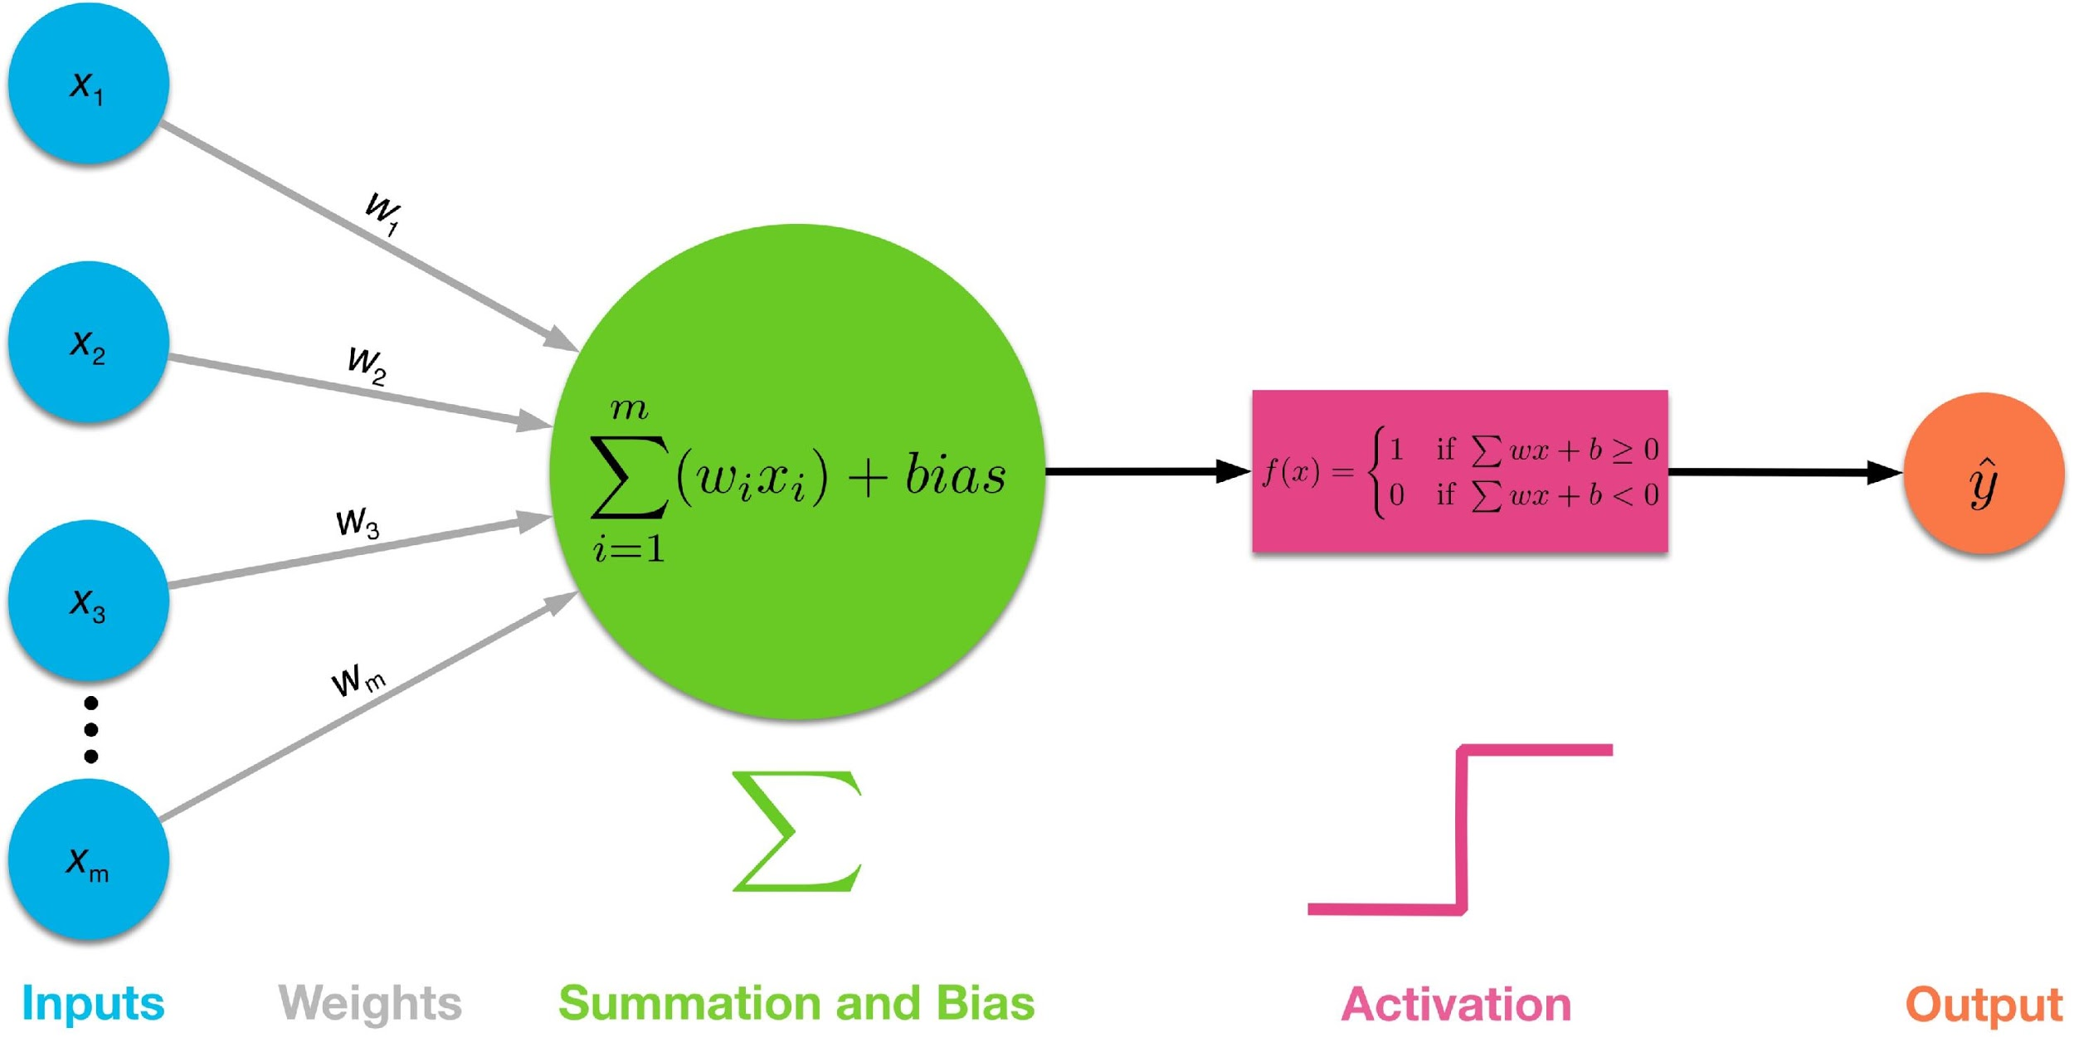
Perceptron
A perceptron is a fundamental building block in neural networks, designed to mimic the function of a biological neuron. It's a simple model that takes multiple inputs, assigns weights to them, sums them up, and then applies an activation function to produce a binary output (0 or 1).
In the equation given above:
“w” = vector of real-valued weights
“b” = bias (an element that adjusts the boundary away from origin without any dependence on the input value)
“x” = vector of input x values
“f” = activation function that decides whether a neuron will fire or not based on threshold

Slide 17
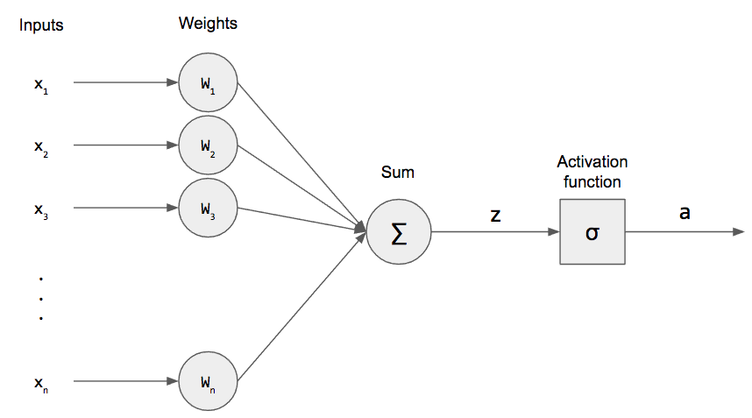
Perceptron network learning
Use perceptron network to learn any function.
Learning process of any neural network has following steps:
Initialize weight values and bias
Forward Propagate
Check the error
Backpropagate and Adjust weights and bias
Repeat for all training examples

Slide 18
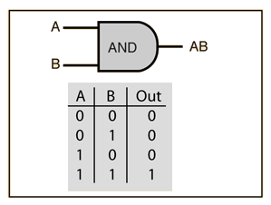
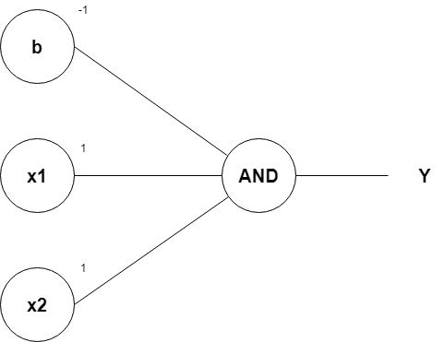
“And Gate” implementation using perceptron
Row 1
From w1*x1+w2*x2+b, initializing w1, w2, as 1 and b as –1, we get;
x1(1)+x2(1)–1
Passing the first row of the AND logic table (x1=0, x2=0), we get;
0+0–1 = –1
From the Perceptron rule, if Wx+b≤0, then y`=0.
Therefore, this row is correct, and no need for Backpropagation.

Slide 19
“And Gate” implementation using perceptron
Row 2 and Row 3
Passing (x1=0 and x2=1), we get;
0+1–1 = 0
From the Perceptron rule, if Wx+b≤0, then y`=0. This row is correct, as the output is 0 for the AND gate.
From the Perceptron rule, this works (for both row 1, row 2 and 3).

Slide 20
“And Gate” implementation using perceptron
Row 4
Passing (x1=1 and x2=1), we get;
1+1–1 = 1
Again, from the perceptron rule, this is still valid
Therefore, we can conclude that the model to achieve an AND gate, using the Perceptron algorithm is;
x1+x2-1

Slide 21
OR Function
X₁ | X ₂ | y
0 | 0 | 0
0 | 1 | 1
1 | 0 | 1
1 | 1 | 1
X ₂
1
1
X₁ + X ₂ − 0.5 = 0
1
0
X₁

Slide 22
OR Function
⎡1 0
⎢1 0
⎢1 1
⎣1 1 1⎦
⎡− 0.5⎤
⎡0⎤
⎢₁⎥
^{0⎤} ⎡− 0.5⎤
₁⎥ ⎢
⎥
⎢ 0.5 ⎥
⎥ ⇒
⇒ ⎢ ⎥
X ^{t}W = ⎢
⎥ ⎢
1
1
_{⎥ =} ⎢
0⎥ ⎢
⎢ 0.5 ⎥
⎣ 1.5 ⎦
⎢1⎥
⎢
⎥ ⎣
⎥
⎢ ⎥
⎢ ⎥
⎦
⎣¹⎦

Slide 23
XOR Function
X₁ | X ₂ | y
0 | 0 | 0
0 | 1 | 1
1 | 0 | 1
1 | 1 | 0
X ₂
1
0
0
1
X₁

Slide 24
XOR Function
X₁ ⊕ X ₂ = ( X₁ + X ₂ ).( X₁ + X ₂ )
X₁ | X ₂ | h₁ = X₁ + X ₂ | h₂ = X₁ + X ₂ | h₁.h₂ = X₁ ⊕ X ₂
0 | 0 | 0 | 1 | 0
0 | 1 | 1 | 1 | 1
1 | 0 | 1 | 1 | 1
1 | 1 | 1 | 0 | 0

Slide 25
XOR Function
_{1 ⎤} ⎡1 1 1 1⎤
0 1 1⎥ = ⎢
1 0
X
⎡− 0.5 1
⎣ 1.5 −1
⎡− 0.5
0.5 0.5 1.5 ⎤
0.5 0.5 − 0.5⎦
⎡0 1 1 1⎤
⎣1 1 1 0⎥
⎦
⎥ ⎢₀
⎥ ⇒
⇒ ⎢
⎢
−1⎦ ⎢
⎥
⎣ 1.5
⎢⎣0
1⎥⎦
_{W} t
h
1
⎡1 0
⎢ 1
⎢1 1
⎣1 1 0⎦
⎡− 0.5⎤
^{1⎤} ⎡−1.5⎤
⎡0⎤
⎢₁
₁⎥ ⎢
⎢ 0.5 ⎥
⎢ ⎥
1
1
⎥
t
⎥ ⎢
_{⎥ =} ⎢
⎥
⇒
h W =
⎢ 0.5 ⎥
0.5⎦
⇒
⎢¹⎥
⎢1⎥
2
1⎥
⎢
⎥ ⎢⎣
⎥⎦
⎢₋ ⎥
⎣
⎢ ⎥
⎣⁰⎦
X₁ ⊕ X ₂

Slide 26
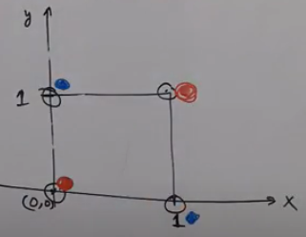
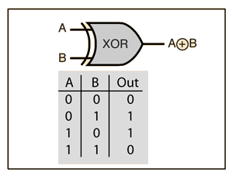
“XOR Gate” implementation using perceptron
Single perceptron can not implement XOR gate

Slide 27
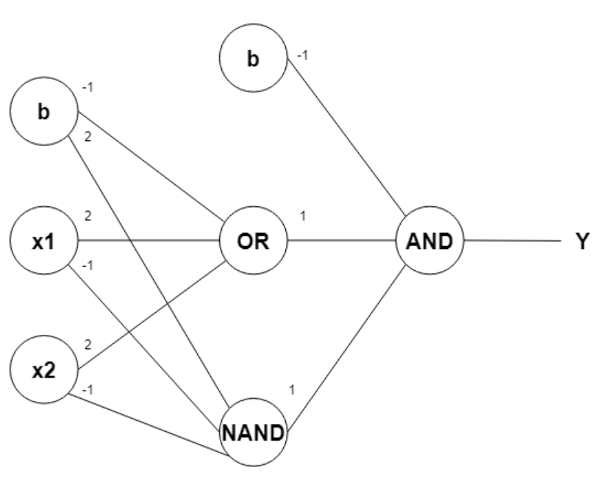
“XOR Gate” implementation using perceptron
Two perceptrons to implement XOR gate

Slide 28
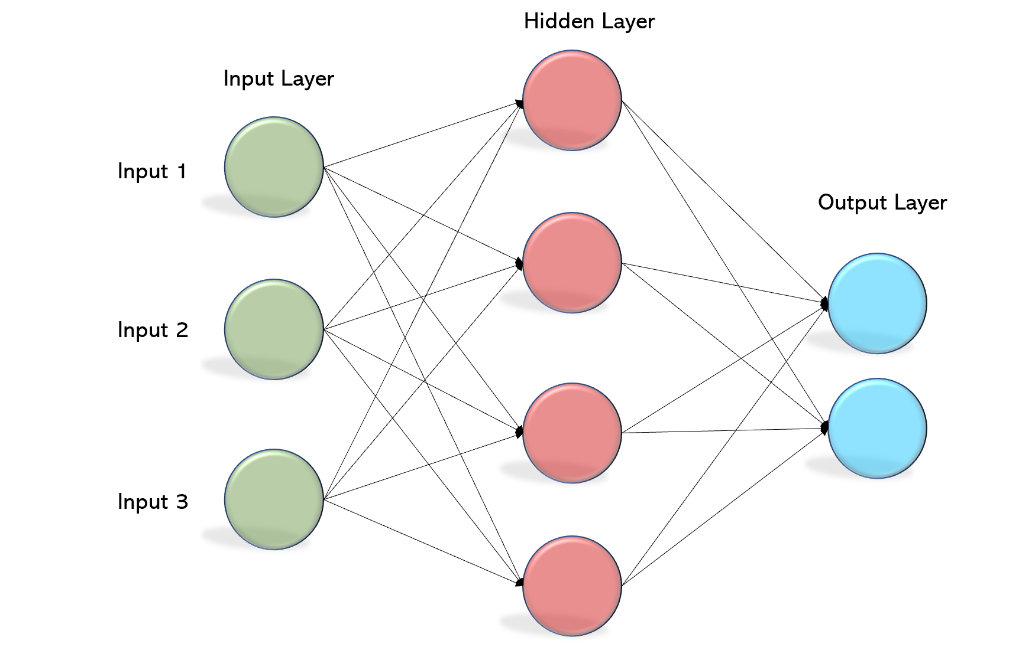
Multilayer perceptron network (fully connected network)

Slide 29
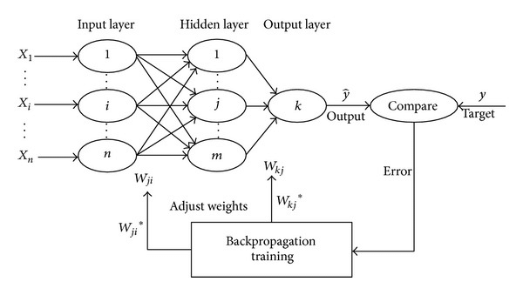
Multilayer perceptron network (fully connected network)

Slide 30
Formal definition of Deep Learning
There is no any specific definition of deep learning. Different sources have given different definition of deep learning.
Layered view:
If number of layers in ANN will be more than two, then that network is termed as “Deep Network”.
In deep learning, the process of creating and selecting features from the data is done automatically by the neural network itself, rather than requiring manual intervention or human-designed features.
Feature Extraction View:
In deep learning, the feature engineering is automatic.,
Wikipedia Says, “Deep learning is part of a broader family of machine learning methods based on artificial neural networks with representation learning”.
“Learning can be supervised, semi-supervised or unsupervised”.

Slide 31
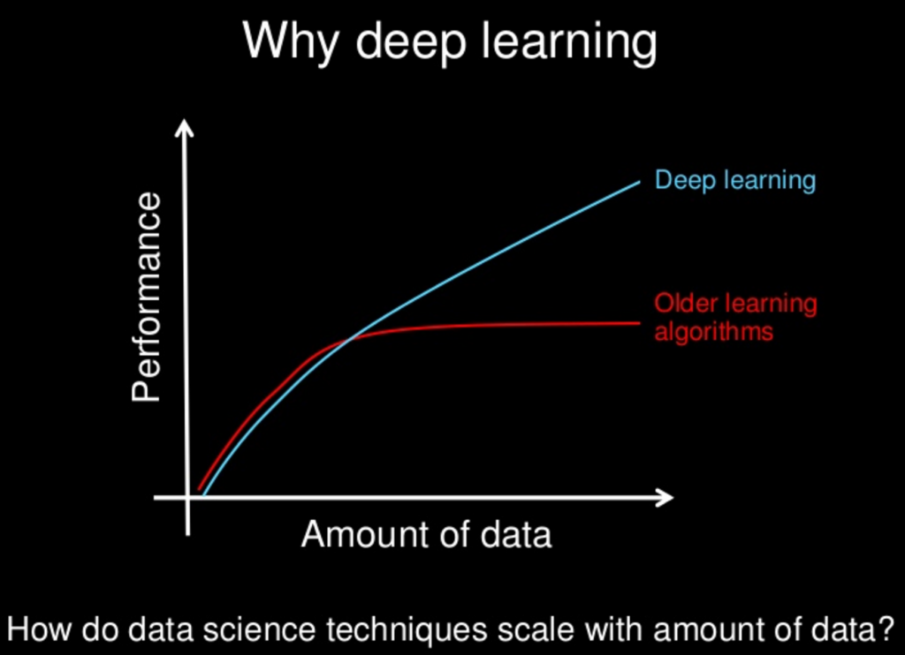
Why deep learning?

